Slide 1
Renewable Energy In Sport
by kiran Johnson

Slide 2
Introduction
Traditional energy sources and uses in sport
Emergence of environmental awareness
Transition from traditional energy sources
Present day state
Concerns
Future developments

Slide 3
Traditional Energy Sources Used in Sporting Events
Fossil Fuels
Electricity Grid

Slide 4

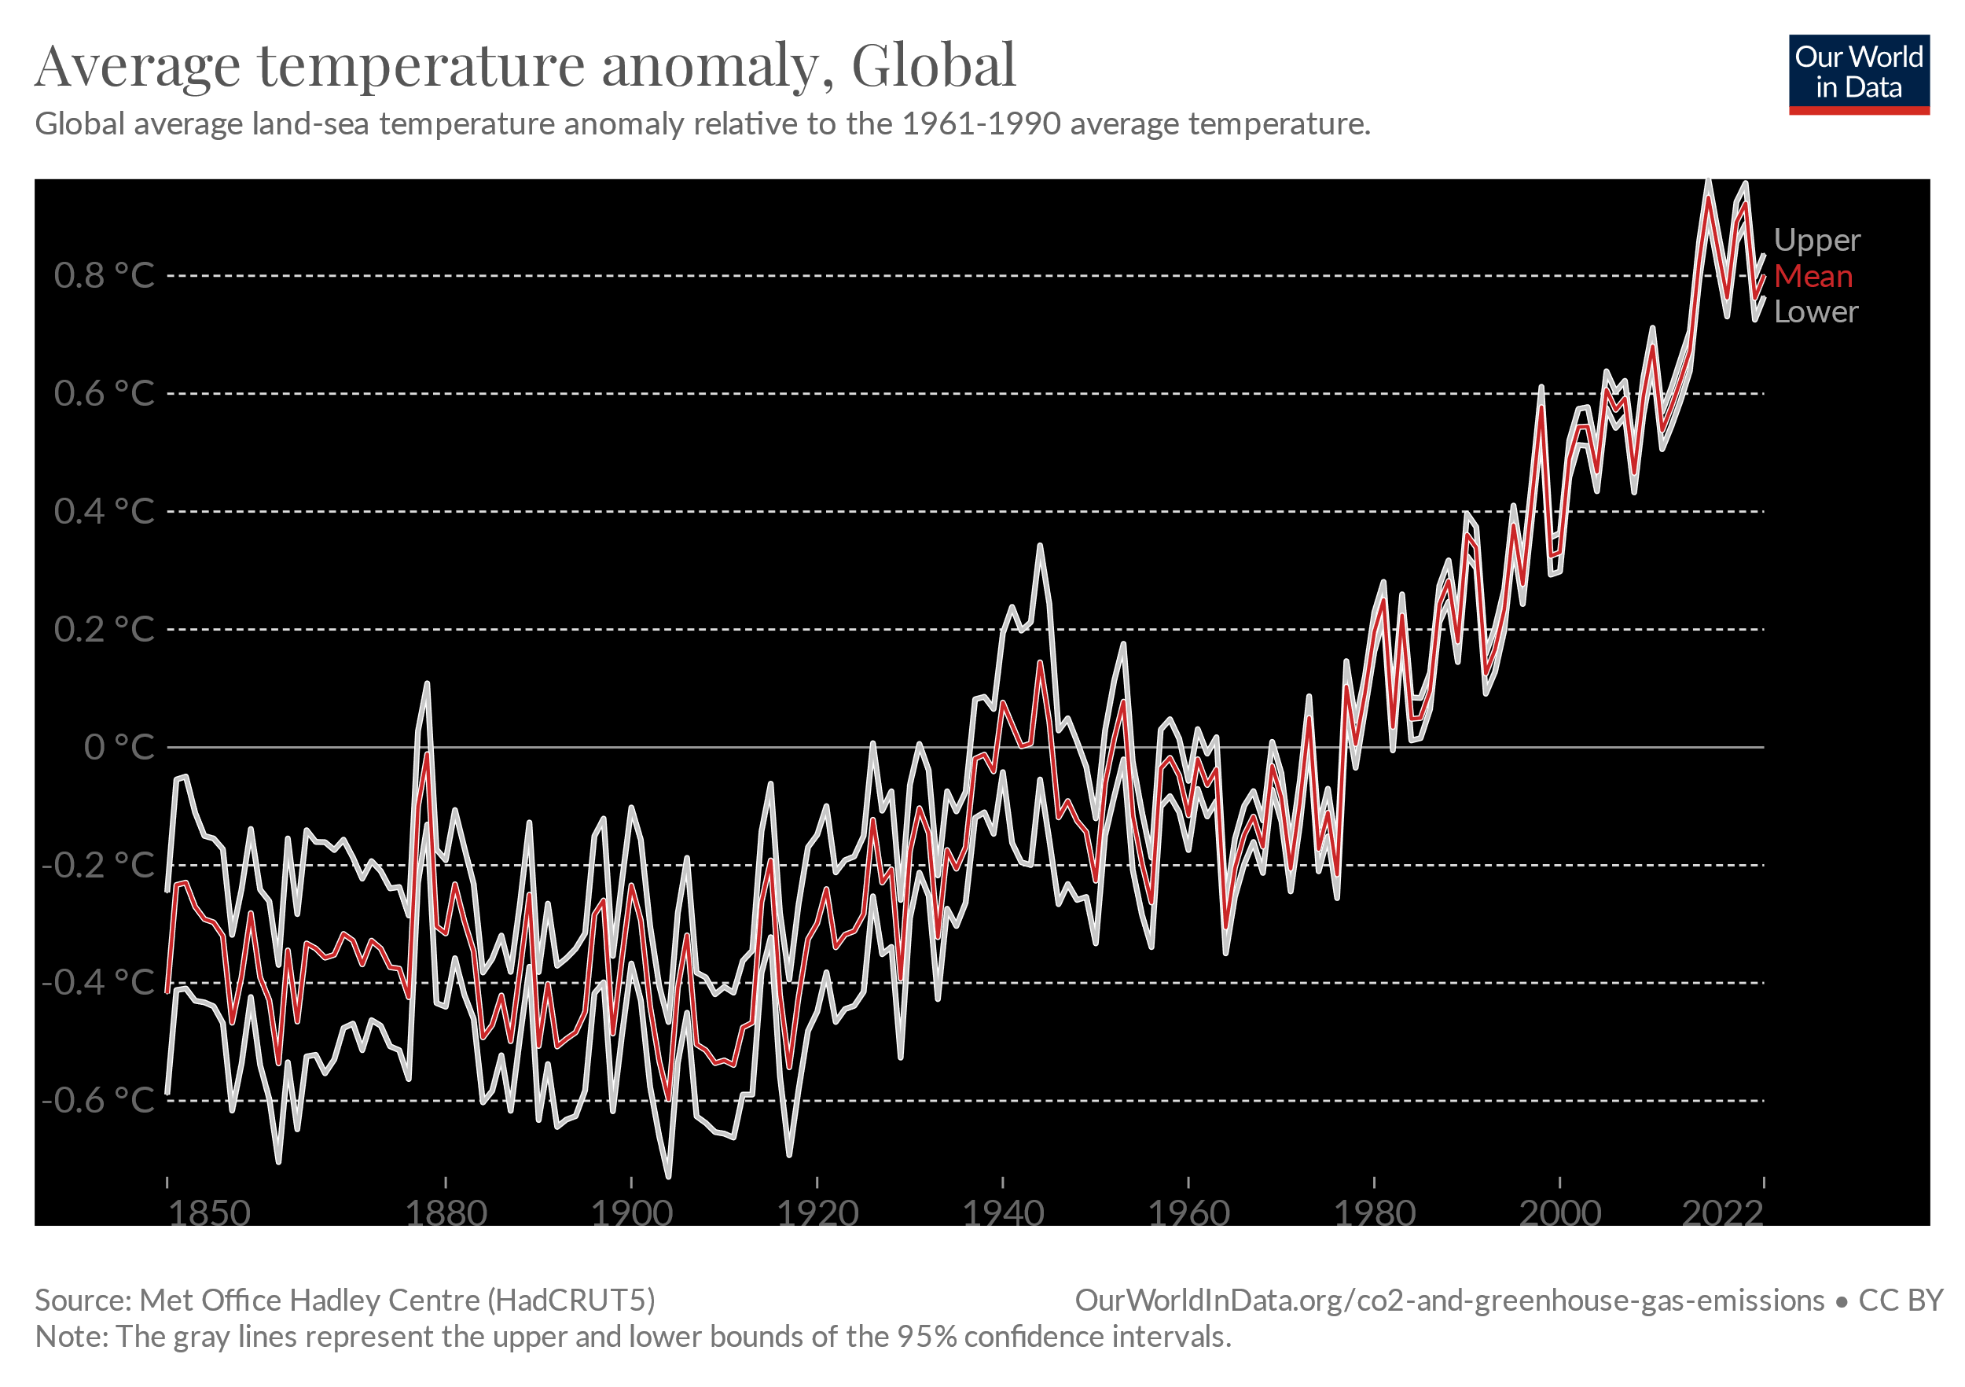
Fossil Fuels
Will run out – non-renewable
Current rate will run out by 2060 (Voss, When will fossil fuels run out? 2019)
Fossil Fuels facilitate sporting events → sport brings in huge revenue
Football’s top 5 leagues generated approx £14.5 billion in 2021/22 (Annual Review of Football Finance, 2023)
3.5 billion football fans worldwide (The Sporting Blog, The 10 most popular sports in the world 2023)
Environment (Causes and effects of climate change, 2022)
Account for 75% of greenhouse gas emissions
Account for 90% of CO2 emissions
Warming the planet

Slide 5

Football (pre-2010)
Fossil Fuels
- Diesel generators for stadium lights
- Transport to stadiums
Electricity Grid
- Stadiums connected to electricity grid
- Relies on coal and natural gas to generate power
- Manchester United’s stadium, Old Trafford, uses up to 25,000 kWh per match day. That is enough to power 10 houses for over a year (Star, Football and energy efficiency 2019).
Carbon emissions
- Contributes to 0.3-0.4% of all global emissions (Ronan, What can the Global Game Do About Football's carbon footprint? 2022)
- Limited awareness
Environment
- 2004 FA cup final at Cardiff’s millennial stadium saw football fans produce 59 tonnes of waste(Jenkins, The environmental impacts of Sport - Cardiff University, 2008).
- Estimated that 20,000 liters of water needed per day to maintain a football pitch (Singapore, Why water is more important to football than you think 2016).

Slide 6
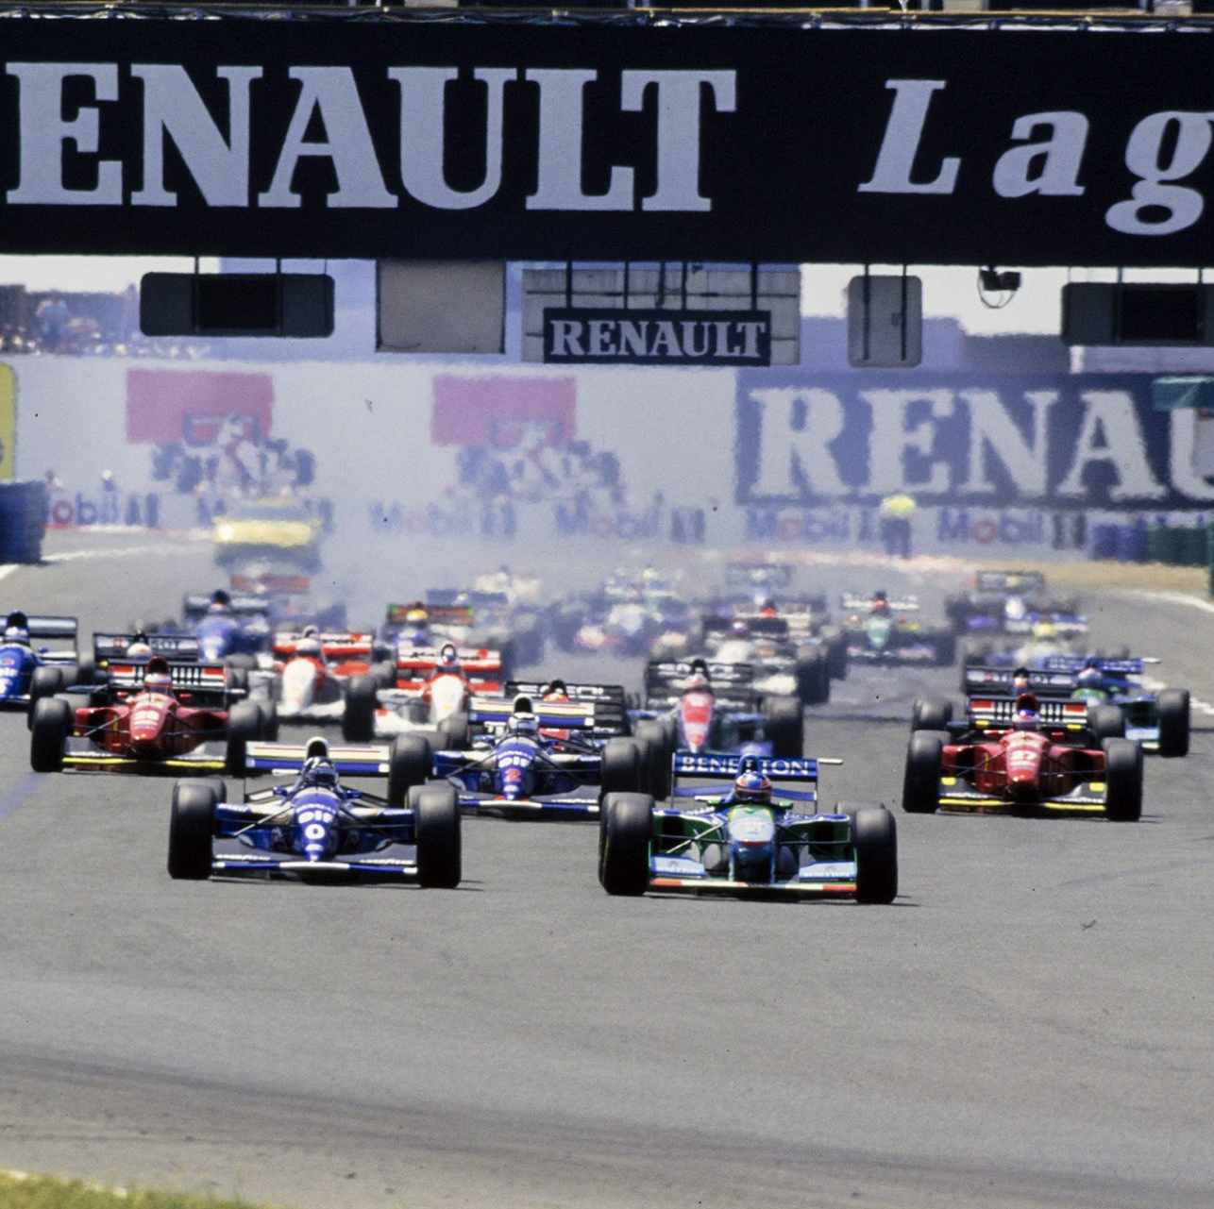
Motorsports (Historical perspective)
Gasoline & Diesel
Two stroke engines
No emission controls
Minimal fuel efficiency concerns
Non-sustainable event management
F1 Grand Prix Singapore – most energy inefficient stadium in the world (Hickson, Ken. Race for sustainability: energy, economy, environment and ethics. World Scientific, 2013)

Slide 7
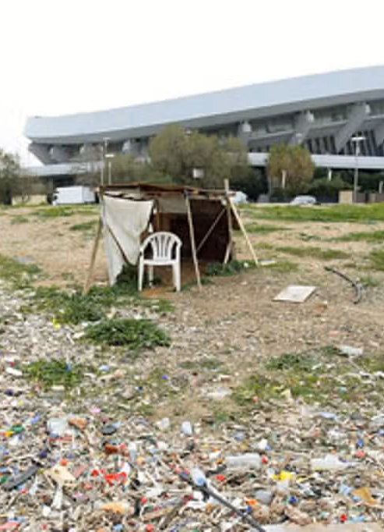
Emergence of Environmental Awareness
Data research, articles & journals
- 2006 super bowl produced 500 tonnes of greenhouse gas Co2 (Schmidt, 2006)
- 2004 summer Olympics produced half a millions tonnes of greenhouse in two weeks (Schmidt, 2006)
Media Coverage (Edgar, Sport and climate change , 2020)
Social Movements
- ‘I hadn’t realised that change Is not a difficult thing’ – Headline article on football fans view on climate change (Amann & Doidge, 2023)
- The Sports for Climate Action Initiative
Environmental Organisations
- FIA (motorsport)
-UEFA
- Green Sports Alliance

Slide 8
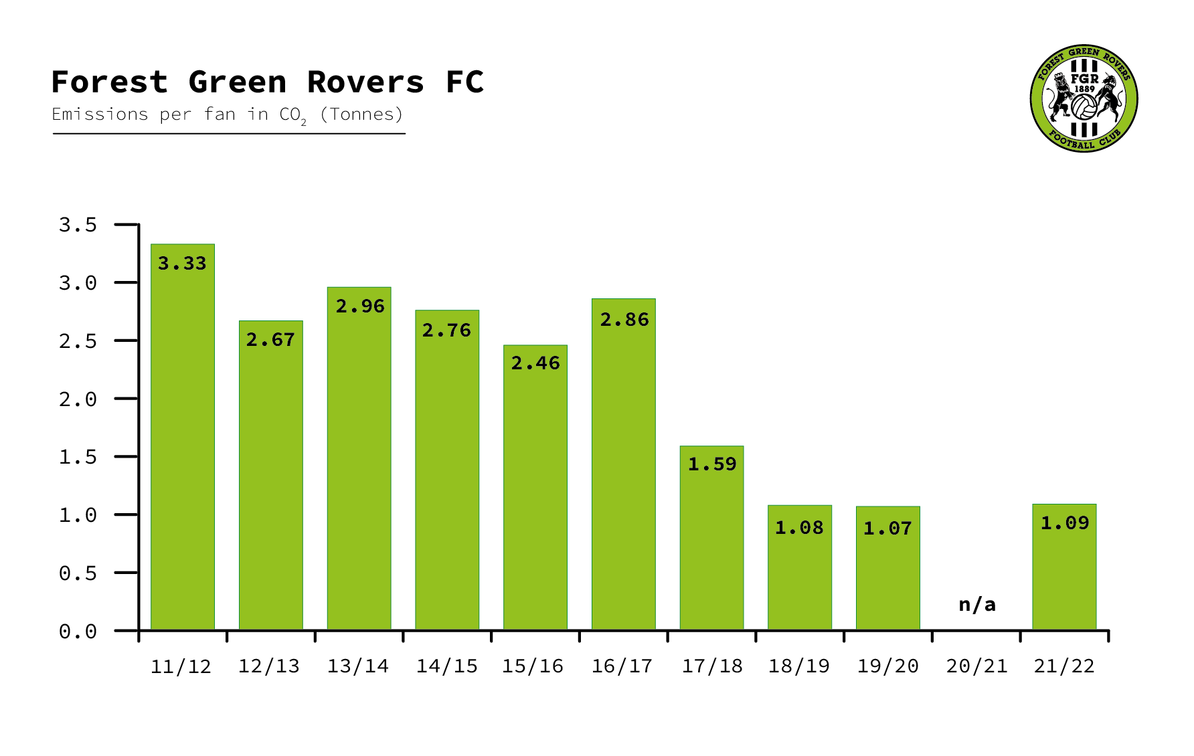
Transition Stage - present day sustainability in football
Brazilian football Pitch Morro da Mineira in Rio de Janeiro (Star, Football and energy efficiency 2019)
- Pavegen tiles sit underneath the pitch and store kinetic energy as players move around the pitch
- Each footstep creates around 7W/s of energy which can then contribute to powering the stadium.
- Average of 99.9 km per match (Poli, Analysis of the distances covered in professional football competitions 2021)
Geocelluar storage(Collier, Sustainable Water Management in sport – can we act differently?, 2022)
- Some stadiums such as Liverpool’s Anfield can control and store rainwater to help contribute to the stadiums demand of water.
Waste Reduction
- Manchester city’s ethiad reduced all single-use plastics -> resulting in over 1 million plastic cups and 500k plastic bottles being saved each season
Forest Green FC (Papp-Vary & Farkas, The World 's first carbon neutral football club, 2022)
- powered by 100% green energy
- Carbon neutral
- solar array & panels, Ecotricity, electric car charging points, water recycling, organic pitch
- Environmentally friendly transport modes

Slide 9
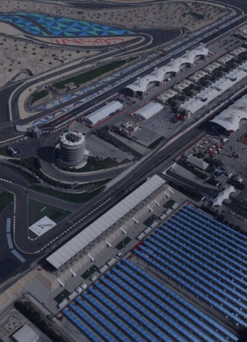
Transition Stage – Present day sustainability in Motorsports
Hybrid Fuel
- F1 Introduced in 2014
- Uses both gas and electric power
- Allows kinetic and heat energy recovery systems
- 85-96% reduction in CO2 emissions (Barretto, Net zero carbon: How formula 1 is going to meet this ambitious target by 2030: Formula 1® 2022)
Circuit de Catalunya and Sakir International Circuit are 100% renewably powered
F1 offices are using 100% renewable energy
Zandvoot F1 – 25,000 fans ditched cars and used pushbikes to get to the track; 45,000 used public transport

Slide 10
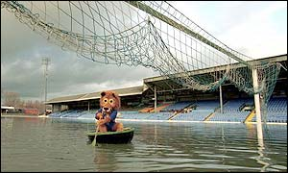
Current Issues
Not all stadiums have state of the art renewable systems
- Financial implications
2021 saw second-largest annual rise of fossil fuel emissions ever recorded resulting in increased flooding (Timms, English football confronts role in Climate Crisis 2022)
-Grassroot football in the UK loses over a month of matches every season due to flooded pitches.
- 25% of English football league stadiums are at risk of annual flooding by 2050 (Pakpahan, Sustainability in English football 2022)
CO2 emissions still high
-F1 produces approximately 256,000 tonnes of CO2 (Underwood, Formula one's environmental impact: Will F1's net-zero goals make a difference? , 2023)
-Football emits about 30 million tonnes of CO2 every year. About the same as Denmark! (Pakpahan, Sustainability in English football 2022)

Slide 11


Addressing Current Issues and looking into the future
20,000 good quality grass football pitches to be developed by 2030 to combat flooding (Timms, English football confronts role in Climate Crisis 2022)
F1’s Net-Zero Carbon (Barretto, Net zero carbon: How formula 1 is going to meet this ambitious target by 2030: Formula 1® 2022)
- 100% sustainable fuel by 2030
- More electrical power by 2026
The FA’s 5-year sustainability strategy
- 1). Shoot for net zero carbon emissions by 2040 2). Save resources e.g., reduce water consumption by 30% for 2028 3). Make an impact e.g., operational framework stratergies and spreading awareness.
The United Nations sport for Climate framework
- Clubs including Liverpool, Tottenham, Southampton and more have joined this initiative and aim to be carbon neutral by 2050.

Slide 12
Q/A

